Slide 1
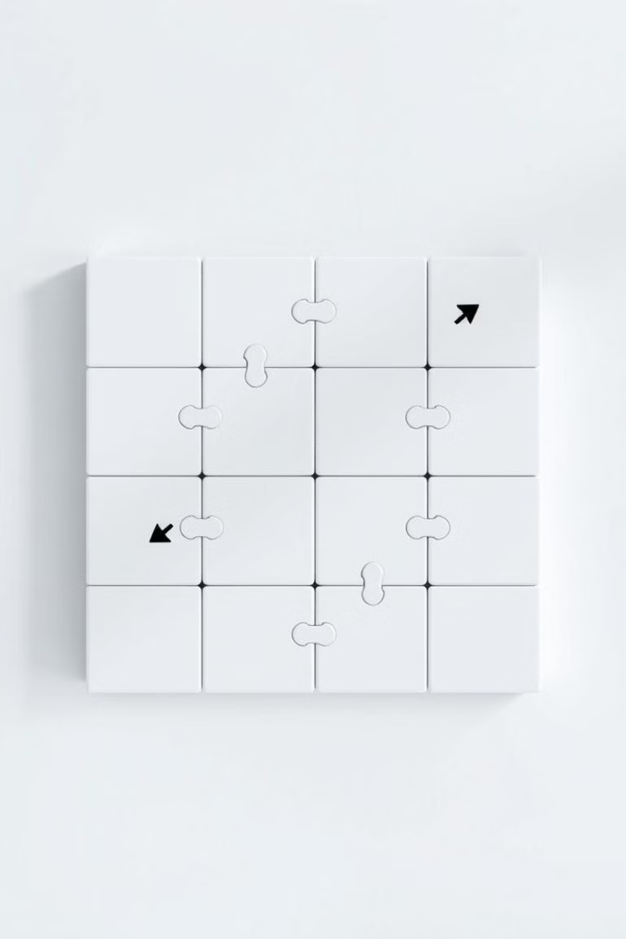
8 Puzzle Problem Solver
This presentation explores an AI-driven solution to the classic 8-puzzle problem. We used the A* search algorithm, a well-known heuristic approach. Our project combines a React frontend with a Flask backend to demonstrate the puzzle-solving logic.

Slide 2

Problem Representation
The 8-puzzle is represented as a 3x3 grid. The empty space, denoted as 0, allows tile movement. Valid moves swap the empty tile with adjacent tiles. The number of possible configurations is 9! / 2 = 181,440.
Grid Representation
Empty Space
Valid Moves
3x3 grid with numbered tiles and an empty space.
Denoted as 0 for tile movement.
Swapping the empty tile with adjacent tiles.

Slide 3


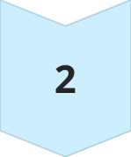
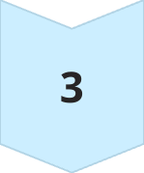
A* Search Algorithm
We used the A* search algorithm. It finds the optimal path to solve the puzzle. The heuristic function is the Manhattan Distance. It calculates the sum of distances from each tile to its goal.
A* Algorithm
Finds the optimal path.
Manhattan Distance
Heuristic function used.
Optimal Solution
Guaranteed shortest path.

Slide 4
Alternative Approaches
We considered alternative approaches to solving the 8-puzzle. Breadth-First Search (BFS) guarantees the shortest path. However, it is inefficient for large state spaces. Depth-First Search (DFS) isn't guaranteed to find an optimal solution.
BFS
DFS
Iterative Deepening A*
Guaranteed shortest path, but inefficient.
Not guaranteed to find an optimal solution.
Combines DFS with A* for memory efficiency.

Slide 5
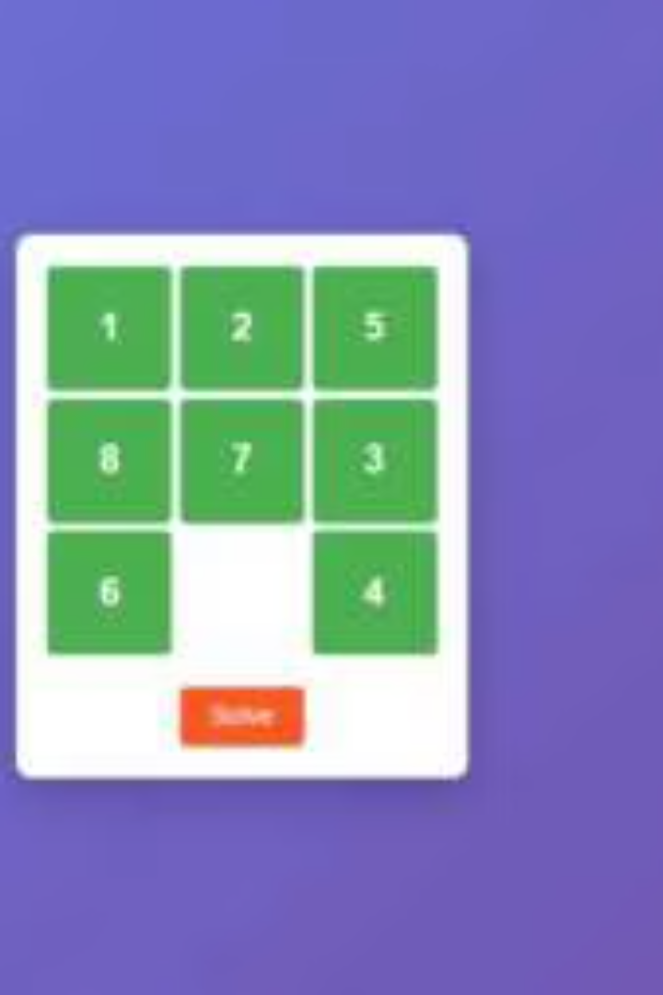
Demo of solution
The React-based front end allows you to set up a new puzzle and see the solved version. It will show the optimal steps to solve.
Set Puzzle
Solve Puzzle
Optimal Steps

Slide 6

Conclusion
The A* search algorithm is effective for solving the 8-puzzle problem. The React frontend provides a user-friendly experience. Our implementation efficiently finds optimal solutions, demonstrating the power of AI in problem-solving.
A* is Effective
Efficient problem-solving.
React Frontend
User-friendly interface.
Optimal Solutions
Power of AI Demonstrated.

